Slide 1
A SMART ACCIDENT DETECTION AND RECOVERY NOTIFICATION SOLUTION

Slide 2
Table of content:
Abstract
Introduction
Literature review
Existing System
Problem statement
Objective
Scope of the Project
Proposed System
Software and hardware requirements
Algorithm and Technique
Architecture
Modules
Implementation
Output/Result
Conclusion
Future Enhancement
Reference

Slide 3

ABSTRACT
Accident detection using computer vision has become a critical area in road safety, aiming to reduce response time and improve emergency management. This project, "Guardian Angel on the Road: A Smart Accident Detection and Recovery Notification Solution," introduces an advanced system for real-time accident detection through video surveillance. The framework utilizes axis bounding box techniques for precise object detection and a centroid-based Gaussian Mixture Model (GMM) for analyzing motion patterns in CCTV footage. This approach ensures high detection accuracy while minimizing false alarms. The system is tested under various environmental conditions, including daylight, low visibility, rain, hail, and snow, proving its robustness across diverse scenarios. Additionally, the project integrates Geopy to capture live location data and automatically notify the nearest police station and hospital with an accident snapshot. This enables authorities to allocate necessary resources efficiently, ensuring timely medical assistance. Furthermore, an alarm buzzer is included to alert nearby individuals, facilitating immediate intervention
KEYWORDS : Axis bounding box , Centroid-based GMM , Machine Learning , Image processing , Video Analytics , Real-Time System.

Slide 4
INTRODUCTION
Road traffic accidents account for over 1.25 million deaths worldwide each year, with delayed response times being a significant factor in fatality rates. Traditional accident reporting relies on human intervention, which often leads to delays in medical assistance. The goal of this project is to develop a real-time, automated accident detection system that minimizes response time by instantly notifying emergency services.
To achieve this, the system integrates computer vision techniques with machine learning algorithms to monitor live traffic footage and identify accidents. It eliminates the need for manual reporting by automatically sending alerts and location data to authorities and nearby hospitals. This ensures that medical help reaches the accident site as quickly as possible.

Slide 5
LITERATURE SURVEY
TITLE :
AUTHOR :
YEAR :
DESCRIPTION :
ACCIDENT PREVENTION, DETECTION AND REPORTING SYSTEM USING ARDUINO
Riya Dev, Sakshi Chaudhary, Abhishek Das
2021
The system is automatic, low cost and power efficient which makes it easy to install in vehicle. Unfortunately, if accident happens to take place, the system detects it and with the help of GPS exact location can be pointed and informed to emergency unit using GSM module. This helps to save many lives by informing rescuing agent in time

Slide 6
TITLE:
AUTHOR:
YEAR:
DESCRIPTION:
ACCIDENT DETECTION AND ALERT SYSTEM
C K Gomathy
2021
This system aims to alert the nearby medical center about the accident to provide immediate medical aid. The attached accelerometer in the vehicle senses the tilt of the vehicle and the a heartbeat sensor on the user's body senses the abnormality of the heartbeat to understand the seriousness of the accident. Thus the systems will make the decision and sends the information to the smartphone, connected to the accelerometer through gsm and gps modules.

Slide 7
TITLE:
AUTHOR:
YEAR:
DESCRIPTION:
AI Enabled Accident Detection and Alert System Using IoT and Deep Learning for Smart Cities
Nikhlesh Pathik , Rajeev Kumar Gupta , Yatendra Sahu
2021
Ensemble transfer learning with dynamic weights is used to minimize the false detection rate. Due to the dataset’s unavailability, a personalized dataset is generated from the various videos available on the Internet. The proposed method is validated by a comparative analysis of ResNet and InceptionResnetV2. The experiment results show that InceptionResnetV2 provides a better performance compared to ResNet with training, validation, and a test accuracy of 98%

Slide 8
EXISTING SYSTEM
Objectives
Disadvantages
1.Collision Detection: Uses accelerometers to measure dynamic forces exceeding a predefined threshold.
2.Rollover Detection: Based on the vehicle’s inclination angle surpassing a threshold.
1.High dependency on sensors, making them costly and power-intensive.
2.Inefficient in cases where sensor failures occur.
3.Delays in accident detection and emergency response.
Machine Learning Models: Artificial Neural Networks (ANN), Support Vector Machines (SVM), and Random Forests (RF) are employed for crash prediction.

Slide 9
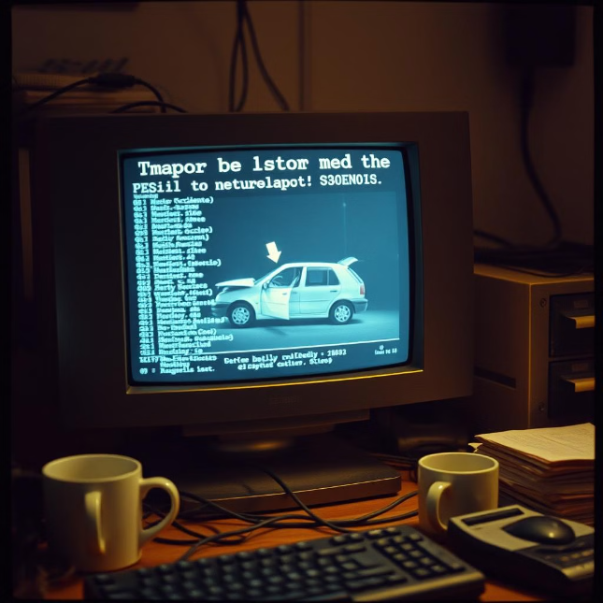
PROBLEM STATEMENT
Timely accident detection is crucial for saving lives, but the existing methods rely on witnesses or drivers to report incidents, which can be unreliable and slow. This project aims to solve the following challenges:
Delayed emergency response due to manual accident reporting.
Inaccurate accident detection in existing systems.
Lack of automated geolocation tracking to guide emergency services.
Inability to detect accidents under different weather and lighting conditions.
By leveraging computer vision and real-time alerts, this project ensures that accidents are detected instantly and reported without human intervention.

Slide 10
OBJECTIVE
The primary objective of this research is to reduce fatalities caused by
accidents by enabling timely detection and response.
The system detects accidents using image and video processing techniques
and promptly notifies nearby hospitals for resource arrangements.
By leveraging CCTV surveillance, it minimizes delays in emergency
response and improves communication between hospitals and accident sites.

Slide 11
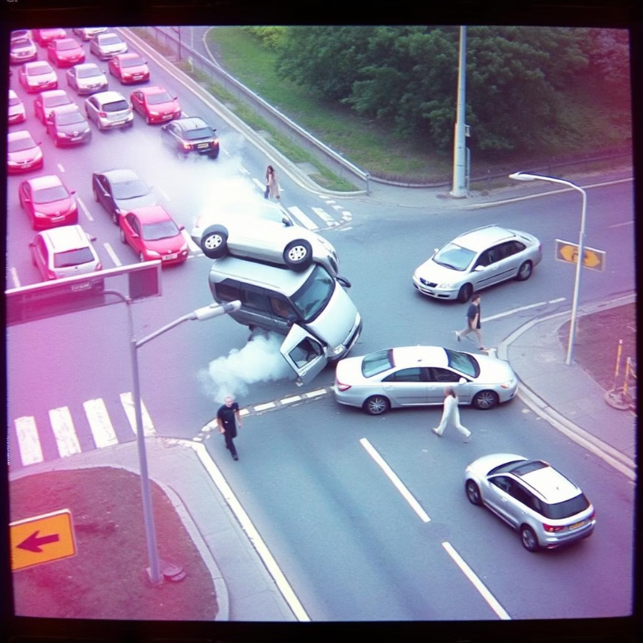
SCOPE OF THE PROJECT
The proposed system has wide-ranging applications and can be seamlessly integrated into smart city infrastructures for real-time accident detection and response. It is particularly beneficial for:
1.Urban traffic management systems to monitor and detect road accidents automatically.
2.Highways and expressways, where accidents often go unnoticed for long periods.
3.Public and private transportation networks, ensuring safer transit.
4.Surveillance-based road safety systems in developing cities.

Slide 12
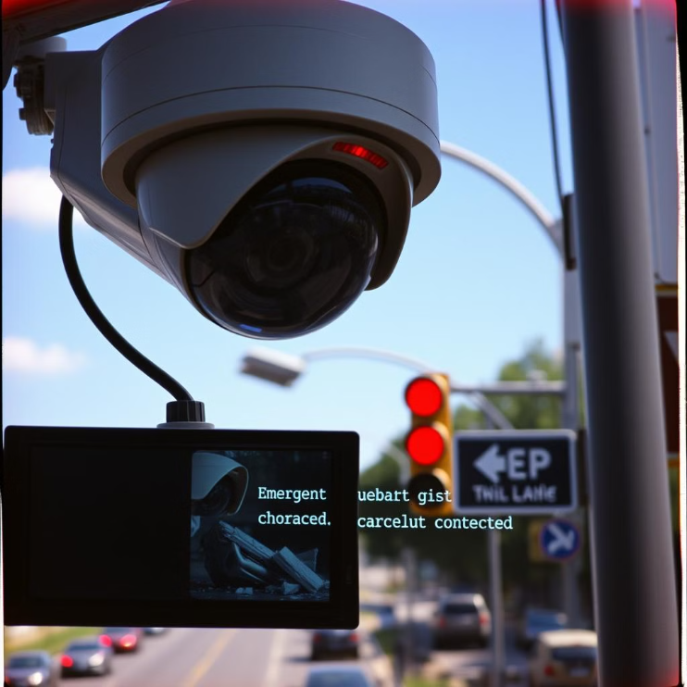
PROPOSED SYSTEM
The proposed system enhances accident detection
by utilizing image and video-based feature
extraction , eliminating the need for additional
hardware sensors. Key features include:
Accident Detection via CCTV Surveillance:
Identifies accidents in real-time from surveillance
footage.
Severity-Based Alert System: Determines
whether the injury is minor or severe and
sends appropriate emergency alerts to nearby
hospitals.
Improved Communication: Reduces response
time by streamlining communication
between accident sites and hospitals.

Slide 13
REQUIREMENT SPECIFICATIONS
HARDWARE REQUIREMENTS
SOFTWARE REQUIREMENTS
Computer or Server: Powerful CPU, GPU (NVIDIA recommended), and at least 16GB RAM.
Operating System: Windows 7 above
Language: Python
Storage: SSD storage for data handling.
Tool: PyCharm
Camera and Capture Devices: High-quality surveillance cameras.
Library:Python (version 3.6.5)
Keras (version 2.1.6)
Network Connectivity: Stable high-speed internet.
TensorFlow (version 1.7.0)
Power Supply: UPS or backup power sources.

Slide 14
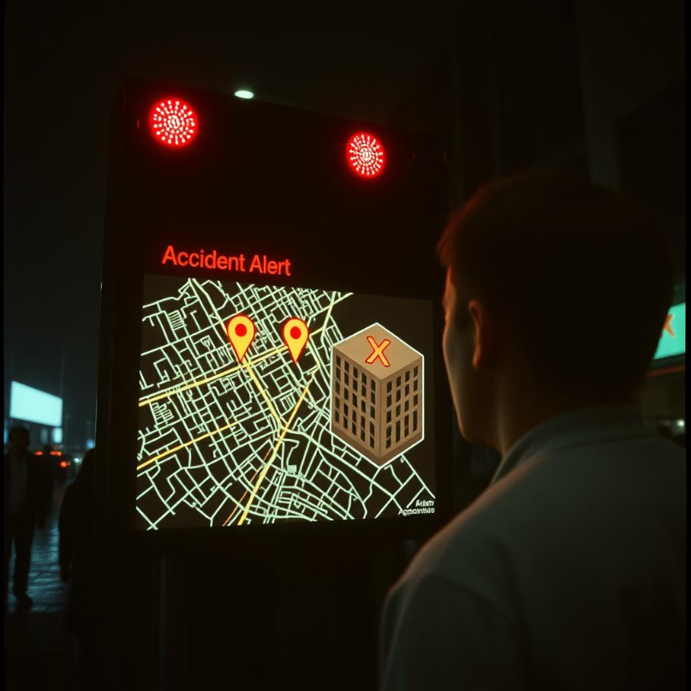
ALGORITHM AND TECHNIQUE
Axis-Aligned Bounding Box (AABB) Technique: Draws rectangular bounding boxes around detected objects for efficient object detection.
Centroid-Based Gaussian Mixture Model (GMM) Algorithm: Analyzes surveillance footage by modeling object movement patterns, distinguishing normal traffic from anomalies such as accidents.
This approach ensures a more effective, sensor-independent accident detection system with faster emergency response, ultimately reducing fatalities.

Slide 15
start
start
Architecture
Video Input
Opencv-cv2 / pre-processing
GMM
No
Bounding box
Accident detection
Smtp/geo-py
Yes
Alarm
Yes
Gmail notification
Alert Neighbours
End
Snap alert/police/hospital

Slide 16
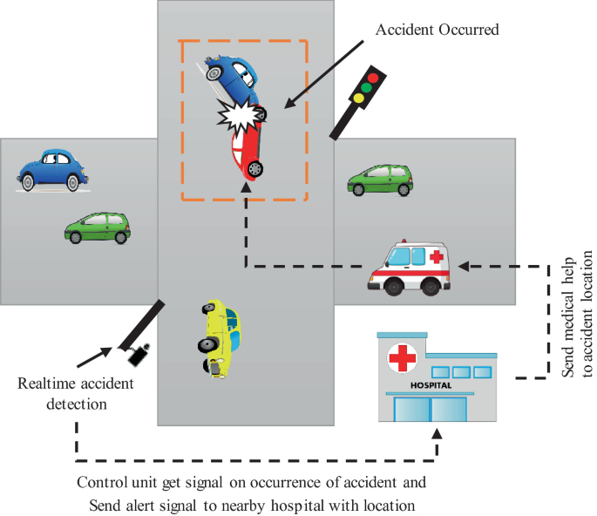
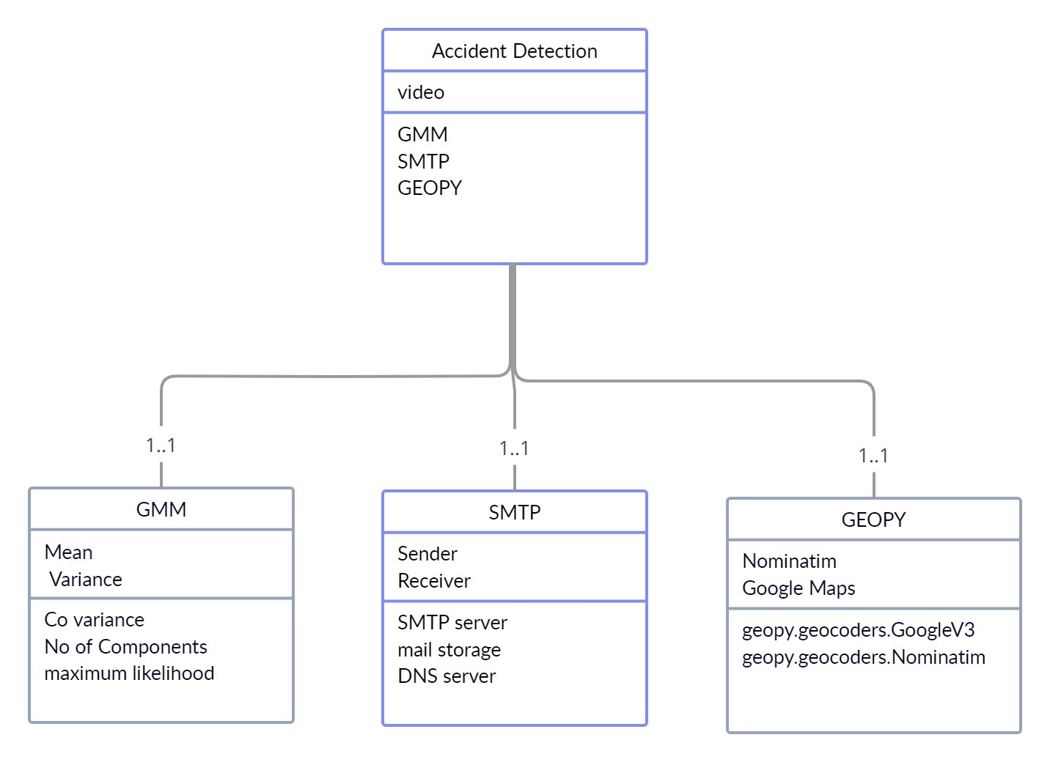


Slide 17
MODULES
1.Input Modules:
The system processes video input from CCTV cameras installed on highways or
accident-prone areas.
OpenCV is used to read the video, capturing frames for further analysis.
The video feed is continuously monitored for detecting potential accidents.
2. Background Learning Modules:
This module distinguishes between the static background and moving foreground objects
in the video feed.
It extracts frames and applies the Mixture of Gaussians (MOG) algorithm to model
background pixels.
The background remains unchanged, while moving objects (vehicles, pedestrians) are
classified as the foreground.
OpenCV’s cv2.createBackgroundSubtractorMOG() function is used to filter background
elements and detect motion effectively.

Slide 18
MODULES
3. Foreground Extraction Module:
This module isolates moving objects using background subtraction techniques.
Key steps involved:
Background Subtraction: Identifies foreground objects by removing static pixels.
Image Enhancement: Noise filtering, dilation, and erosion techniques refine object contours.
Foreground Extraction: Clearly identifies moving vehicles and potential accident scenarios.
4. Accident Detection Module:
The system analyzes extracted foreground objects and applies contour-based feature extraction.
Key features such as centroid, aspect ratio, area, size, and solidity are computed for vehicle classification.
Bounding boxes are drawn around moving vehicles. When two bounding boxes overlap or collide, the system detects a potential accident.
The collision detection mechanism determines whether the event is an accident or normal vehicle movement.
This modular approach ensures real-time accident detection, enabling timely alerts and emergency response, ultimately reducing fatalities.

Slide 19
Coding
import smtplib
import cv2
from email.mime.multipart import MIMEMultipart
from email.mime.text import MIMEText
from email.mime.base import MIMEBase
from email import encoders
import geocoder
import folium
from cv2 import imwrite
# Email Configuration (Replace with your actual credentials)
EMAIL_ADDRESS = "ksvarani204@gmail.com"
EMAIL_PASSWORD = "najc qfgd bkul vkge" # Use an App Password for Gmail
# Video Capture
cap = cv2.VideoCapture("assets/test_0.mp4") # Change video source if needed
if not cap.isOpened():

Slide 20
print("Initializing the capture...")
cap.open("assets/accident.mp4")
print("Done.")
# Background Subtractor
subtractor = cv2.createBackgroundSubtractorMOG2(history=50, varThreshold=20)
# Text Settings
font = cv2.FONT_HERSHEY_SIMPLEX
org = (40, 50)
fontScale = 0.8
color = (0, 0, 255)
thickness = 2
arcount = 0 # Counter for accident detection
count = -1
while True:
res, frame = cap.read()
if not res:

Slide 21
break # Stop if video ends
# Apply Background Subtraction
mask = subtractor.apply(frame)
# Find Contours
contours, _ = cv2.findContours(mask, cv2.RETR_EXTERNAL, cv2.CHAIN_APPROX_NONE)
# Accident Detection Flag
flag = 0
for cnts in contours:
(x, y, w, h) = cv2.boundingRect(cnts)
if w * h > 1000:
if flag == 1:
cv2.rectangle(frame, (x, y), (x + w, y + h), (0, 0, 255), 3) # Red if accident detected
else:
cv2.rectangle(frame, (x, y), (x + w, y + h), (0, 255, 0), 3) # Green for normal detection

Slide 22
# If area exceeds threshold, possible accident
if w * h > 10000:
arcount += 1 # Frame counter for accident
if arcount > 35:
flag = 1 # Accident confirmed
if flag == 1:
frame = cv2.putText(frame, "🚨 Accident Detected 🚨", org, font, fontScale, color, thickness, cv2.LINE_AA, False)
try:
# Get Current Location
g = geocoder.ip('me')
if g.latlng:
latitude, longitude = g.latlng
print(f"Accident Location: {latitude}, {longitude}")
# Generate Google Maps Link
google_maps_link = f"https://www.google.com/maps?q={latitude},{longitude}"

Slide 23
# Create Map with Folium
accident_map = folium.Map(location=[latitude, longitude], zoom_start=15)
folium.Marker([latitude, longitude], popup="Accident Location", icon=folium.Icon(color="red")).add_to(accident_map)
accident_map.save("map.html") # Save map as HTML
# Save accident frame image
imwrite("accident.png", frame)
# Email Setup
msg = MIMEMultipart()
msg['From'] = EMAIL_ADDRESS
msg['To'] = EMAIL_ADDRESS
msg['Subject'] = "🚨 URGENT: Accident Detected - Immediate Attention Required 🚨"
# Email Body (Formatted for readability)
email_body = f"""
🚨 **Accident Alert!** 🚨

Slide 24
📌 **Location:**
📍 **Latitude:** {latitude}
📍 **Longitude:** {longitude}
🗺 **View on Google Maps:**
🔗 [Click Here]({google_maps_link})
**Immediate action is required.**
Please check the attached map and captured accident image.
Regards,
**Automated Accident Detection System**
"""
msg.attach(MIMEText(email_body, 'plain'))
# Attach Accident Image
with open("accident.png", "rb") as attachment:
p = MIMEBase('application', 'octet-stream')
p.set_payload(attachment.read())

Slide 25
encoders.encode_base64(p)
p.add_header('Content-Disposition', 'attachment; filename="accident.png"')
msg.attach(p)
# Attach Map
with open("map.html", "rb") as attachment:
p = MIMEBase('application', 'octet-stream')
p.set_payload(attachment.read())
encoders.encode_base64(p)
p.add_header('Content-Disposition', 'attachment; filename="map.html"')
msg.attach(p)
# Send Email via SMTP
s = smtplib.SMTP('smtp.gmail.com', 587)
s.starttls()
s.login(EMAIL_ADDRESS, EMAIL_PASSWORD) # Secure authentication
s.sendmail(EMAIL_ADDRESS, EMAIL_ADDRESS, msg.as_string())
s.quit()
print("🚀 Accident report sent successfully via email!")

Slide 26
else:
print("❌ Location not found. Unable to send geolocation details.")
except Exception as e:
print(f"⚠️ Error in sending email: {e}")
cv2.imshow("Accident Detection", frame)
count += 1
if cv2.waitKey(33) & 0xFF == 27: # Press ESC to exit
break
cap.release()
cv2.destroyAllWindows()

Slide 27
import cv2
import time
# Capturing Video
cap = cv2.VideoCapture("assets/test_0.mp4")
#cap = cv2.VideoCapture("assets/test_23.mp4")
#cap = cv2.VideoCapture("assets/1.mp4")
if not cap.isOpened():
print("Initialising the capture...")
cap.open("assets/accident.mp4")
print("Done.")
# Subtracting the background
subtractor = cv2.createBackgroundSubtractorMOG2(history=50, varThreshold=20)
# Text setting up
font = cv2.FONT_HERSHEY_SIMPLEX

Slide 28
# org
org = (40, 50)
# fontScale
fontScale = 0.8
# Blue color in BGR
color = (0, 0, 255)
# Line thickness of 2 px
thickness = 2
res = 1
arcount = 0
count = -1

Slide 29
while True:
# Reading the frame
res, frame = cap.read()
if res == True:
# Applying the mask
mask = subtractor.apply(frame)
# finding the contours
contours, hierarchy = cv2.findContours(
mask, cv2.RETR_EXTERNAL, cv2.CHAIN_APPROX_NONE)
# Flag for accident detection
flag = 0
for cnts in contours:
(x, y, w, h) = cv2.boundingRect(cnts)
if w * h > 1000:
if flag == 1:
_

Slide 30
# If accident detected change color if contours to red
cv2.rectangle(frame, (x, y), (x + w, y + h),
(0, 0, 255), 3)
else:
cv2.rectangle(frame, (x, y), (x + w, y + h),
(0, 255, 0), 3)
# If area of rectangle more than a threshold detect accident
if w * h > 10000:
area = w * h
# Countint the number of frames for which the condition persists to refine the accident detection case
arcount += 1
# print(arcount)
if arcount > 35:
flag = 1
if flag == 1:
# If accident detected print Accident on the screen
frame = cv2.putText(frame, "Accident ; ", org, font,

Slide 31
fontScale, color, thickness, cv2.LINE_AA, False)
# frame = cv2.putText(frame, "28° 35' 31.7040'' N and 77° 2' 45.7836'' E. ; ",
# (40, 80), font, fontScale, color, thickness, cv2.LINE_AA, False)
# frame = cv2.putText(frame, "time:1600 hrs; ", (40, 100),
# font, fontScale, color, thickness, cv2.LINE_AA, False)
# frame = cv2.putText(frame, "camera id:DWARKA_ROAD_22", (40, 120),
# font, fontScale, color, thickness, cv2.LINE_AA, False)
cv2.imshow("Accident detection", frame)
count += 1
if cv2.waitKey(33) & 0xff == 27:
break
else:
break

Slide 32
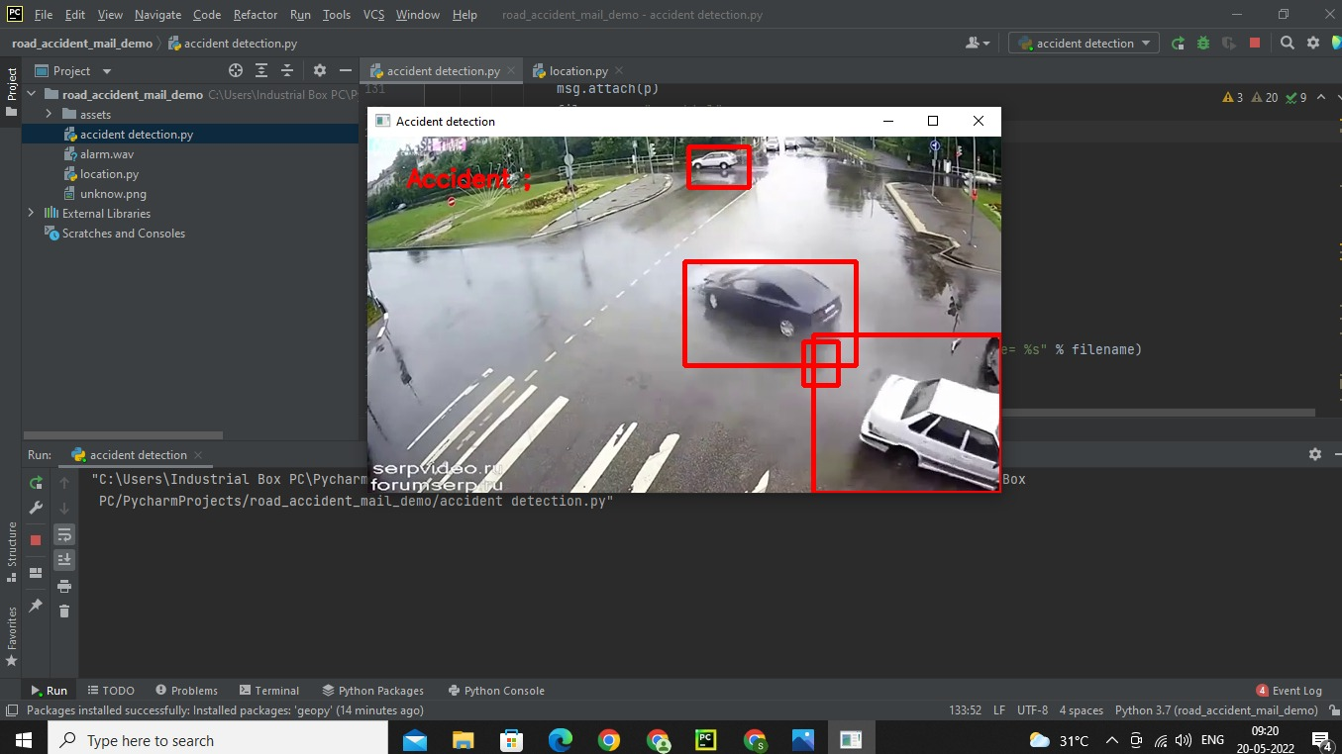
OUTPUT:

Slide 33
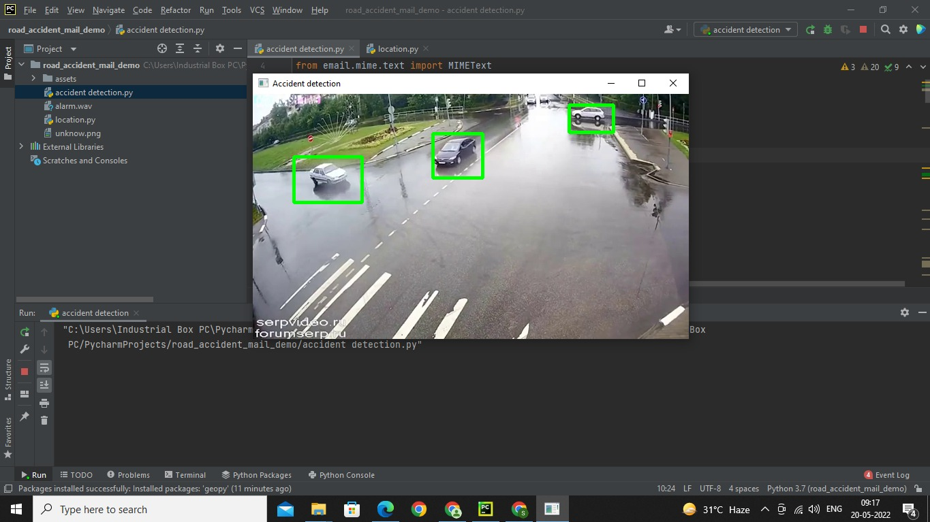

Slide 34
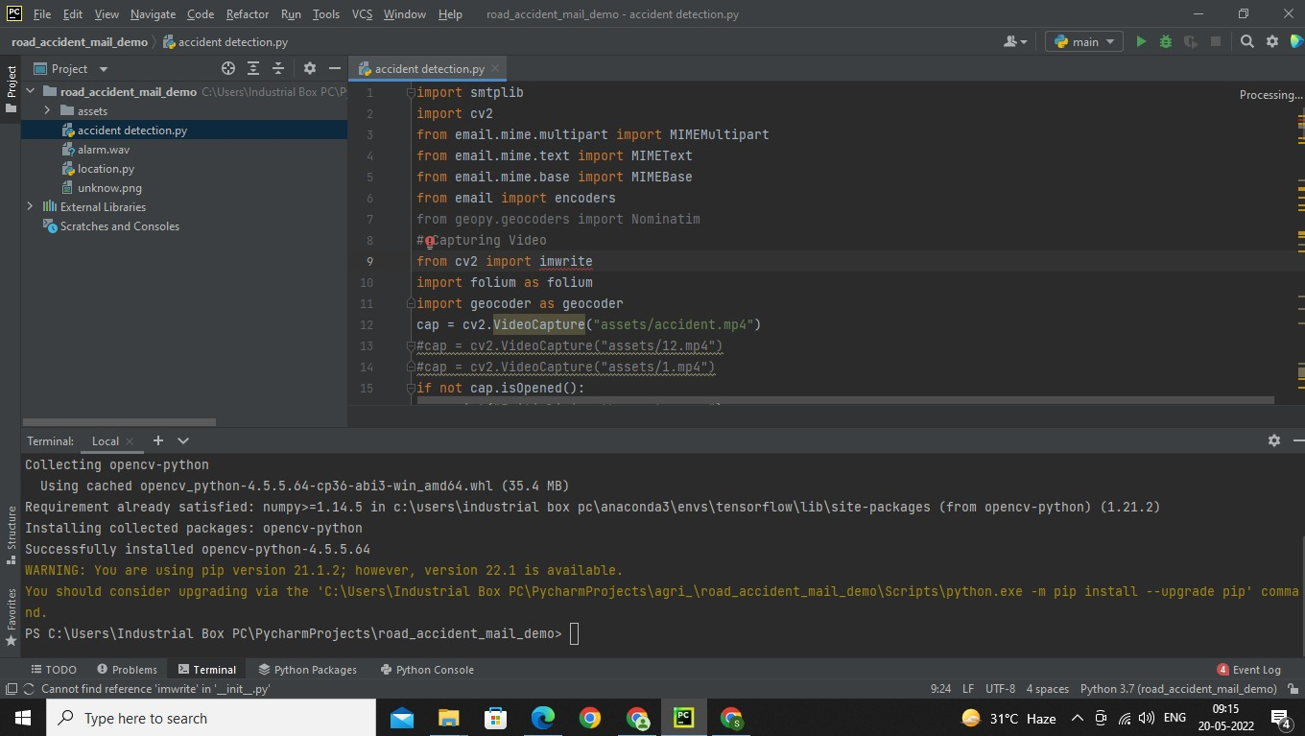

Slide 35
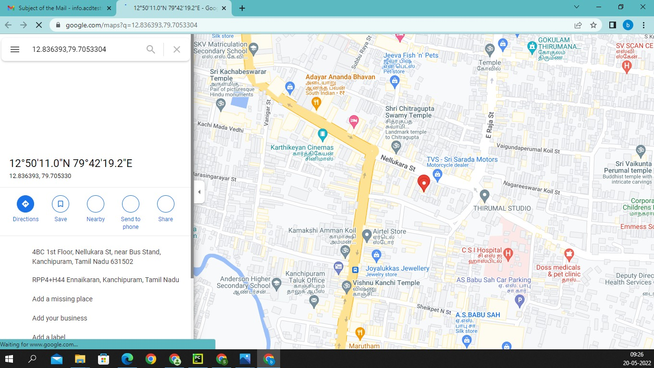

Slide 36
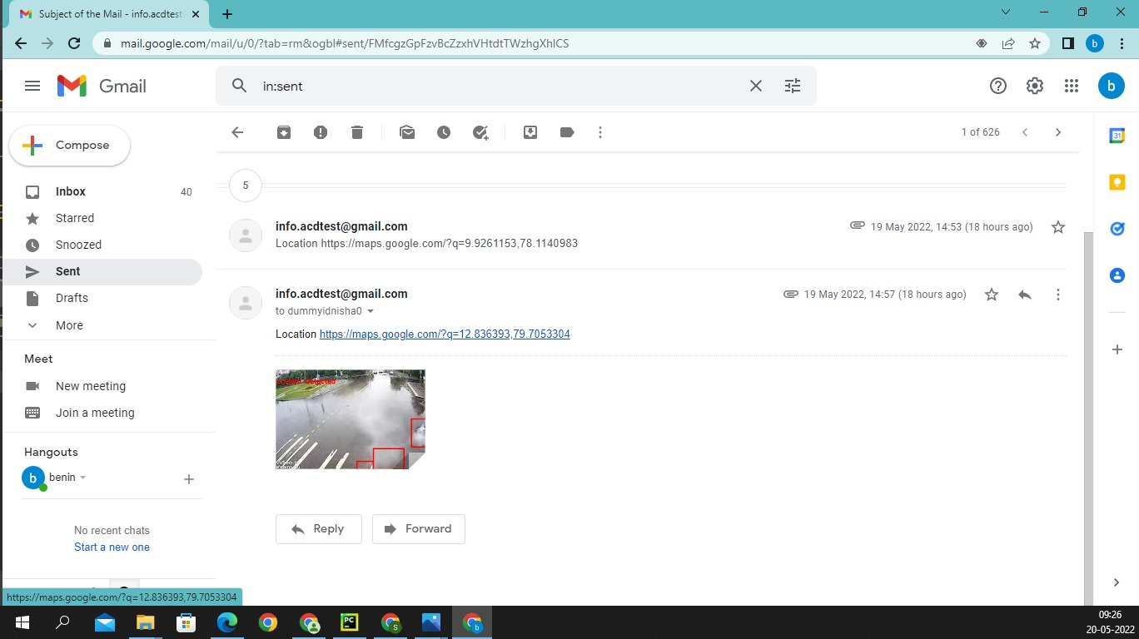

Slide 37
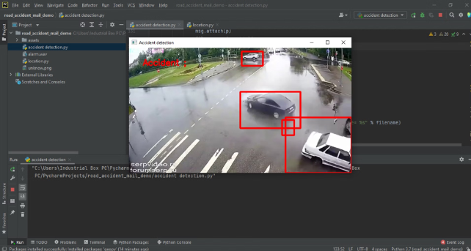
CONCLUSION:
The proposed accident detection system is implemented using Python and OpenCV, analyzing traffic camera footage from various sources. The system applies image processing techniques to detect accidents after selecting a region of interest (ROI). Currently, the system works with pre-recorded videos, but it can be modified to process live video streams for real-time accident detection. This approach significantly reduces emergency response time, helping to save lives.

Slide 38
FUTURE ENHANCEMENT
Advanced Feature Classification: Implementing a secondary classification based on vehicle colour or shape can improve detection accuracy in occluded conditions.
Automated ROI Selection: Introducing deep learning-based automated region selection will eliminate human dependency.
Camera Calibration Techniques: Using lane detection and calibration can improve system performance under varying camera angles.
Night-Time Detection Improvements: Incorporating infrared cameras or thermal imaging can enhance accident detection in low-light environments.
Live Video Processing: Extending the system to real-time streaming will enable immediate accident detection and emergency response.

Slide 39
REFERENCES
Rajvardhan Rishi, SofiyaYede, Keshav Kunal, Nutan V. Bansode," Automatic Messaging System for Vehicle Tracking and Accident Detection, Proceedings of the International Conference on Electronics and Sustainable Communication Systems, ICESC, 2020.
MrS.Kailasam, MrKarthiga, DrKartheeban, R.M.Priyadarshani, K.Anithadevi, "Accident Alert System using face Recognition", IEEE, 2019.
T Kalyani, S Monika, B Naresh, Mahendra Vucha, "Accident Detection and Alert System", 201914.Bharath P, Saravanan M, Aravindhan K," Literature Survey on Smart Vehicle Accident Prediction Using Machine Learning Algorithm", 2019.
Aarya D.S, Athulya C.K, Anas.P, Basil Kuriakose, Jerin Susan Joy, Leena Thomas, "Accident Alert and Tracking Using Arduino", International Journal of Advanced Research in Electrical, Electronics and Instrumentation Engineering, Vol. 7, Issue 4, April 2018.
Nagarjuna R Vatti, PrasannaLakshmiVatti, RambabuVatti, ChandrashekharGarde, "Smart Road Accident Detection and communication System", 8 IEEE International Conference on Current Trends toward Converging Technologies, Coimbatore, India, 2018.
Wen-Kai Tai", Hao-Cheng Wang, Cheng-Yu Chiang, Chin-YuehChien, Kevin Lai, and TsengChang Huang," RTAIS: Road Traffic Accident Information System", 20th International Conference on High Performance Computing and Communications, 2018.
Nicky Kattukkaran, Arun George, MithunHaridas T.P, "Intelligent Accident Detection and Alert System for Emergency Medical Assistance", International Conference on Computer Communication and Informatics, 2017.
Usman Khalil, Tariq Javid, Adnan Nasir, "Automatic road accident detection techniques: A brief survey", in proceedings of IEEE Symposium on-Wireless Systems and Networks (ISWSN), 2017, 19- 22 Nov. 2017, Lahore, Pakistan.
HarmilaGaikwad, "Mobile Agents in Heterogeneous Database Environment for Emergency Healthcare System", at ITNG 2008 5th International Conference on Information Technology- New Generations April 7-9, 2008, Las Vegas, Nevada, USA. Published in IEEE Computer society, ISBN:978-0-7695-3099-4, PP.1220-1221

Slide 40
9. DnyaneshDalvi, Vinit Agrawal, SagarBansod, Apurv Jadhav, Prof. MinalShahakar, "Android Application for Automatic Accident Detection", 2017.
Miss. Priyanka M. Sankpal, Prof. P. P. More "Accident Avoidance System Using IR Transmitter", IJRASET, Volume 5 Issue IV, April 2017.
BarışGuksa and BurcuErkmen, "Smart Phone Application for Drowsiness Detection during Driving, International Conference on Frontiers of Sensors Technologies, 2017.
P. Kaliuga Lakshmi, C. Thangamani, "An efficient vehicle accident detection using sensor technology", 2016.
Harit Sharma, Ravi Kanth Reddy, ArchanaKarthik, "S-CarCrash: Real-time Crash Detection Analysis and Emergency Alert using Smartphone", ICCVE, 2016.
PrashantKapri, ShubhamPatane, Arul Shalom A, "Accident Detection & Alert System", IEEE, 2018 Bruno Fernandes, Vitor Gomes, Joaquim Ferreira and Arnaldo Oliveira, "Mobile Application for Automatic Accident Detection and Multimodal Alert", IEEE, 2015.
Adnan Bin Faiz, Ahmed Imteaj, Mahfuzulhoq Chowdhury, "Smart Vehicle Accident Detection and Alarming System Using a Smartphone", International Conference on Computer & Information Engineering, 2015.
Manuel Fogue, PiedadGarrido, Francisco J. Martinez, A System for Automatic Notification and Severity Estimation of Automotive Accidents", IEEE, 2014.
Hossam M. Sherif, Hossam M. Sherif, Samah A. Senbel, "Real Time Traffic Accident Detection System using Wireless Sensor Network", International Conference of Soft Computing and Pattern Recognition, 2014.
Md. Syedul Amin, JubayerJalil, M. B. I. Reaz, "Accident Detection and Reporting System using GPS, GPRS and GSM Technology", ICIEV, 2012.

Slide 41
THANK YOU

